Slide 1
Web-editor for reproducible pipelines
Resources and microservices
Access to K8S Cluster: Sergeev Ilya

Slide 2
Product description
A web application and a visual studio code extension for editing pipelines with auto-saving and automatic syntax and cohesion checking, embedded into the “MLOps Platform”.
MLDev experiments configurations CRUD.
Online editor with syntax highlighting, formatting.
Real Time collaboration with built-in git support system.
Experiments visualizer.
Team: Daniil Fedorov (Architect, system analyst), Sergeev Ilya (Architect, full-stack developer), Shtanov Andrey (Architect, UI-developer)
Repo: https://github.com/dr0p-table-users/asd
Report: https://docs.google.com/presentation/d/1pje2W9pGmORkrRjzaBEfAczLazg_F9HpnyR5zC0pUDA/edit?usp=sharing

Slide 3
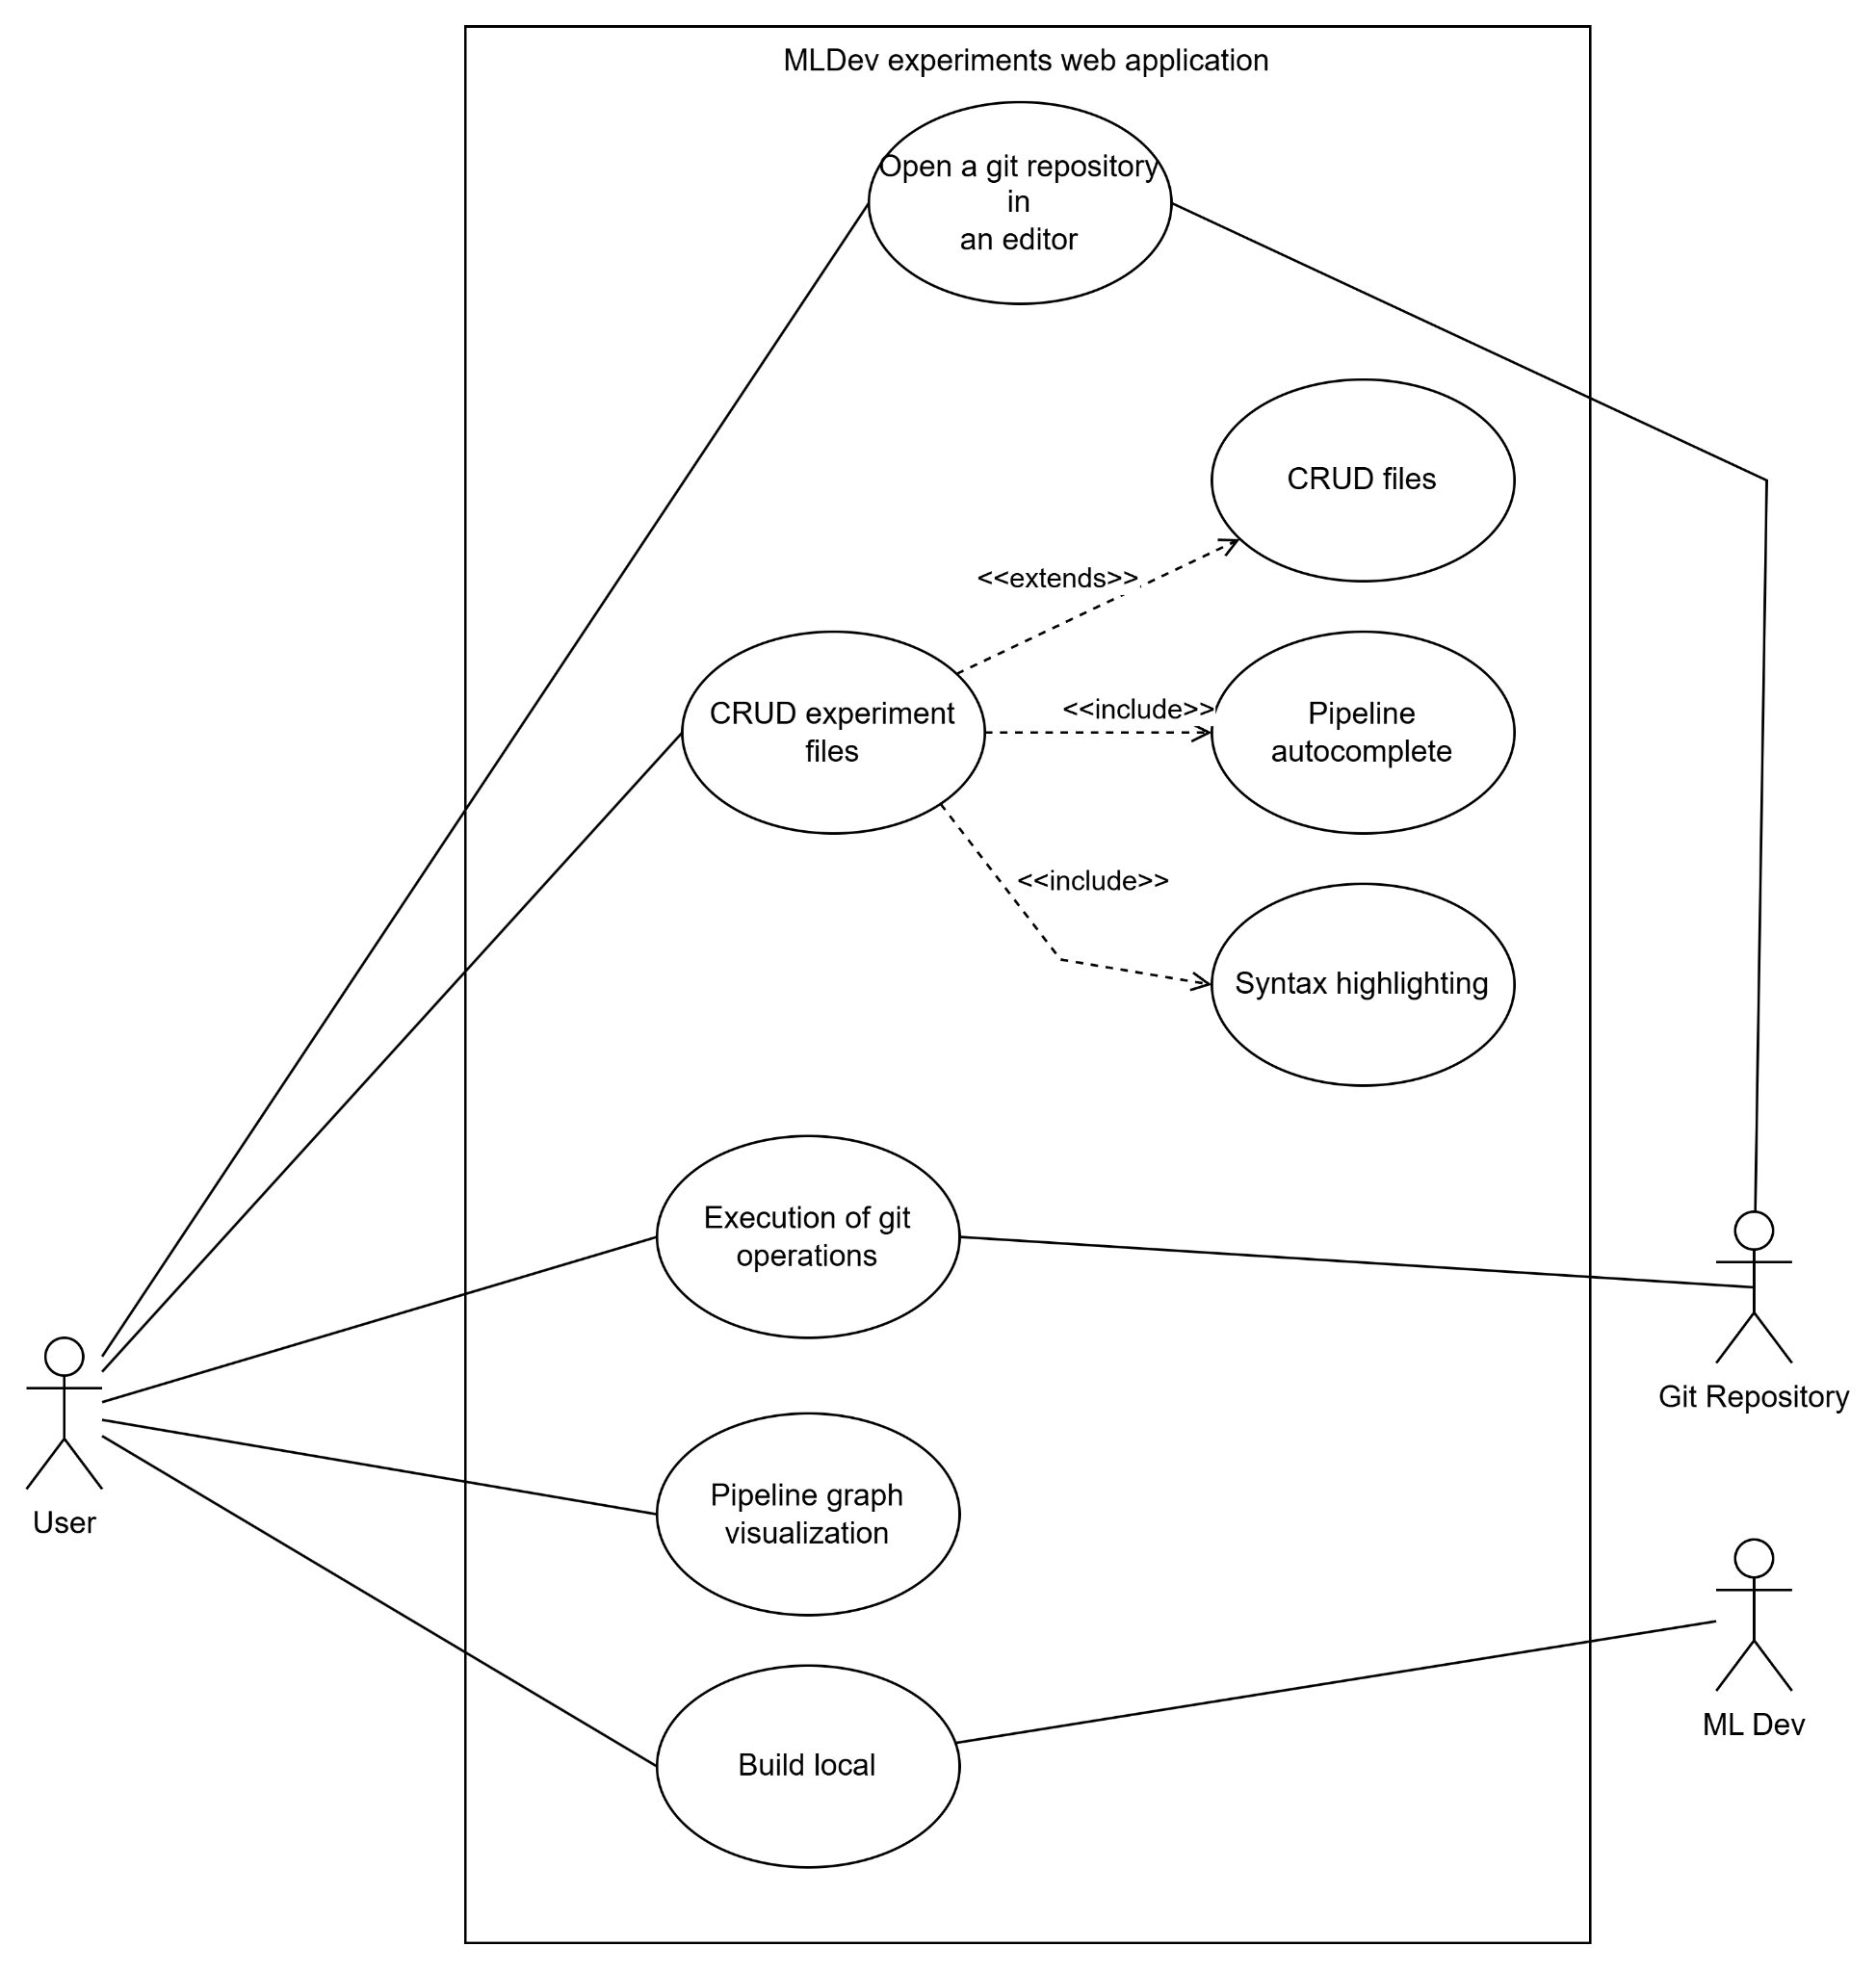
Use case diagram

Slide 4
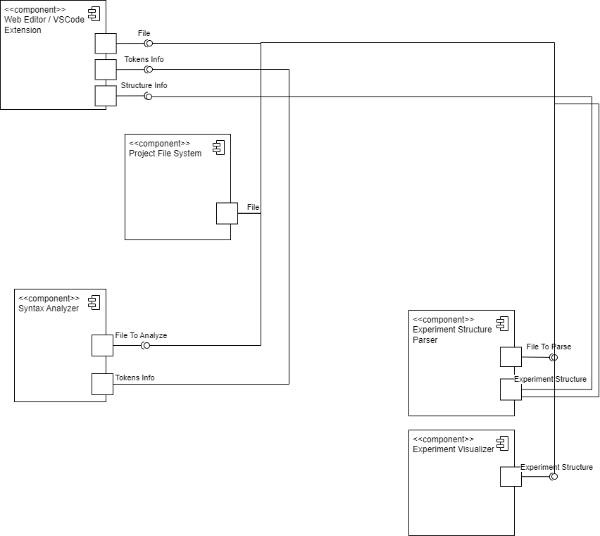
Service diagram

Slide 5
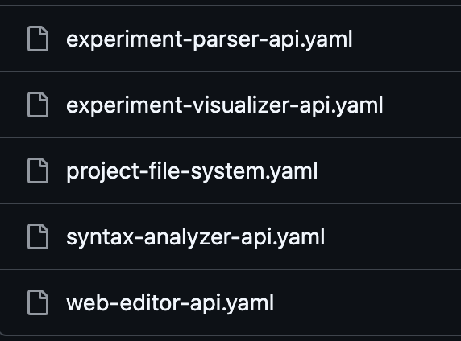
Open API

Slide 6
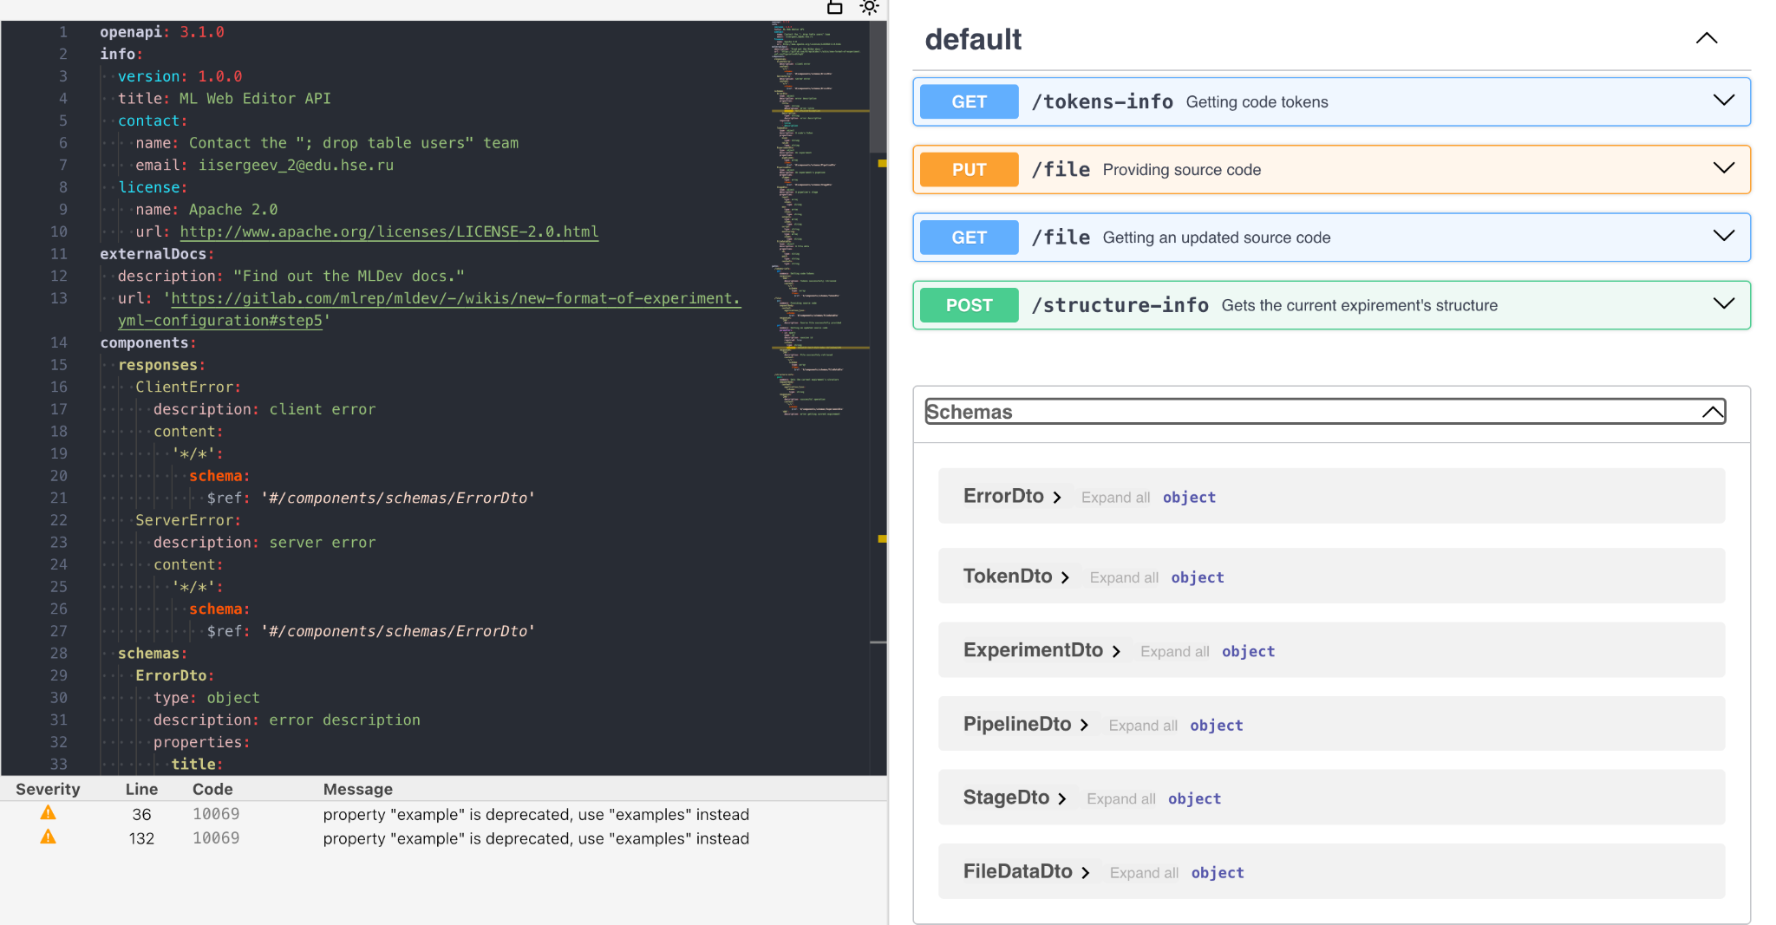
Open API. Web Editor

Slide 7
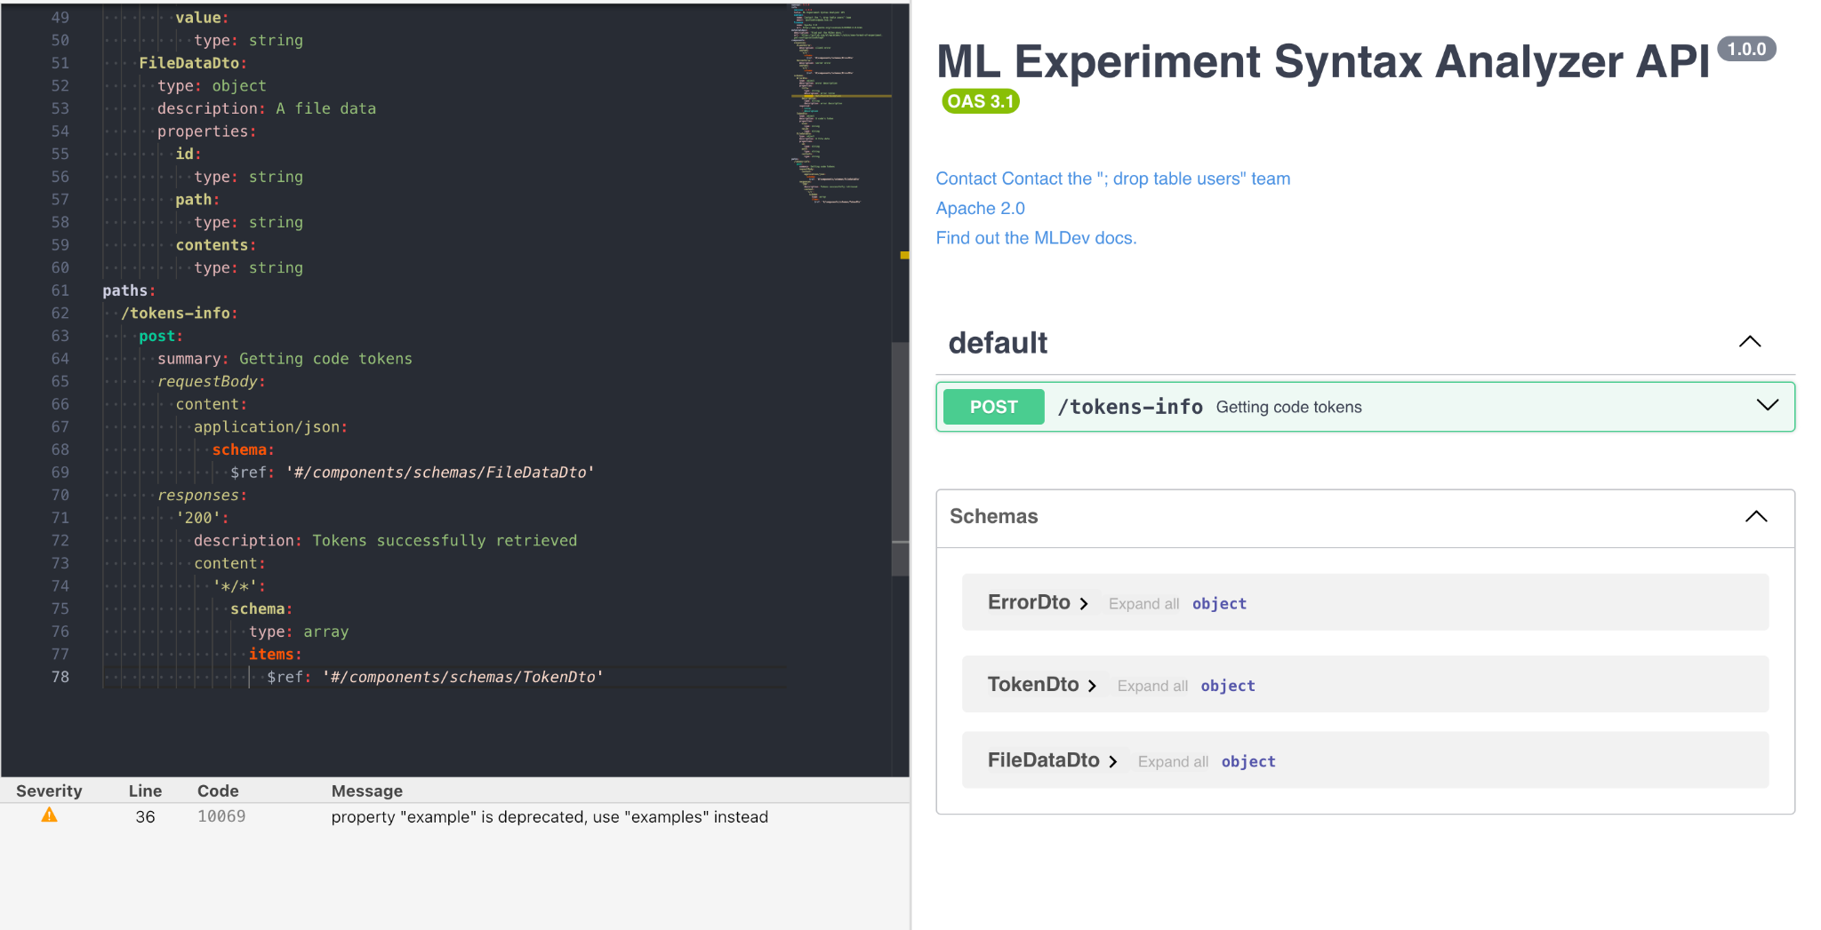
Open API. Syntax Analyzer

Slide 8
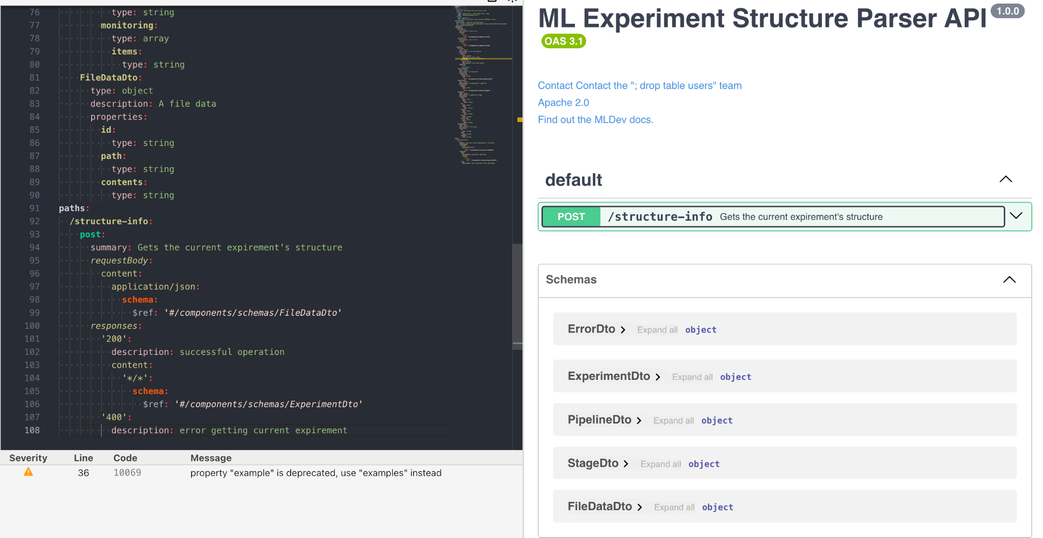
Open API. Experiment Structure Parser

Slide 9
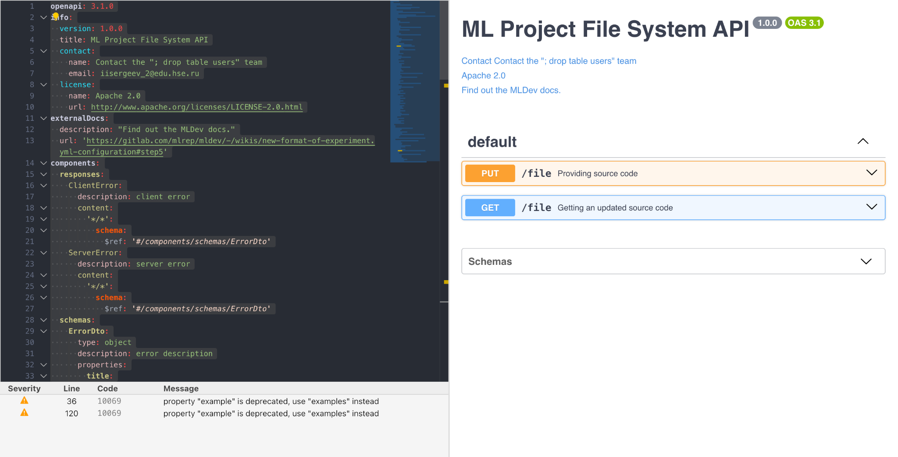
Open API. Project File System

Slide 10
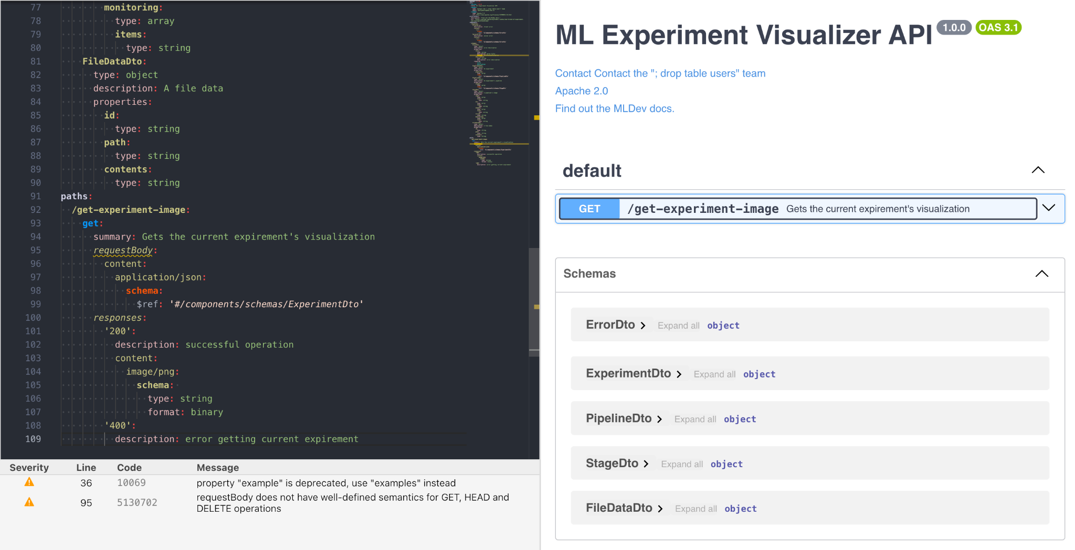
Open API. Experiment Visualizer

Slide 11
Solution stack: Web Editor
Implementation
API definition: OpenAPI
Connection server for API: HTTP REST API + service workers for offline communication
App framework: TypeScript + “vscode” SDK or a micro frontend in “React”
Serialization/state format (json, xml, protobuf…)
Asynchronous interactions
Message bus: Postal.js
Testing tools
“Jest” with over 33m. downloads/week
Operations
Code build: “Webpack 5” (due to extensibility and reach support)
CI/CD pipeline: “Github actions” (due to reach functionality)
Delivery method: the “vsce” tool

Slide 12
Solution stack: Syntax Analyzer
Implementation
API definition: OpenAPI
Connection server for API: HTTP REST API + service workers for offline communication
App framework: TypeScript, Express.js
Serialization/state format (json, xml, protobuf…)
Asynchronous interactions
Message bus: Postal.js
Testing tools
“Jest” with over 33m. downloads/week
Operations
Code build: “Webpack 5” (due to extensibility and reach support)
CI/CD pipeline: “Github actions” (due to reach functionality)
Delivery method: docker

Slide 13
Solution stack: Experiment Parser
Implementation
API definition: OpenAPI
Connection server for API: HTTP REST API + service workers for offline communication
App framework: TypeScript, Express.js
Serialization/state format (json, xml, protobuf…)
Asynchronous interactions
Message bus: Postal.js
Testing tools
“Jest” with over 33m. downloads/week
Operations
Code build: “Webpack 5” (due to extensibility and reach support)
CI/CD pipeline: “Github actions” (due to reach functionality)
Delivery method: docker

Slide 14
Solution stack: Project File System
Implementation
API definition: OpenAPI
Connection server for API: HTTP REST API + service workers for offline communication
App framework: TypeScript, Express.js
Serialization/state format (json, xml, protobuf…)
Asynchronous interactions
Message bus: Postal.js
Testing tools
“Jest” with over 33m. downloads/week
Operations
Code build: “Webpack 5” (due to extensibility and reach support)
CI/CD pipeline: “Github actions” (due to reach functionality)
Delivery method: docker

Slide 15
Solution stack: Experiment Visualizer
Implementation
API definition: OpenAPI
Connection server for API: HTTP REST API + service workers for offline communication
App framework: TypeScript, Express.js, React.js (for simple frontend)
Serialization/state format (json, xml, protobuf…)
Asynchronous interactions
Message bus: Postal.js
Testing tools
“Jest” with over 33m. downloads/week
Operations
Code build: “Webpack 5” (due to extensibility and reach support)
CI/CD pipeline: “Github actions” (due to reach functionality)
Delivery method: docker

